Slide 1

Housing Finance
Module 4
Ifra Fathima I

Slide 2
Definition
Housing finance is a complex process that integrates multi-sector issues driven by constantly changing local features such as the country’s legal or cultural environment, economic makeup, political system, and regulatory framework.

Slide 3
Key Discussion Points and Examples:
Economic Linkages and Contribution to GDP: The housing sector is deeply intertwined with macroeconomic stability. It is the second largest employer in India, subsequent only to agriculture. The sources provide a clear measure of its impact: for every Indian rupee invested in housing, INR 0.78 is added to the country's Gross Domestic Product (GDP). Furthermore, the sector has strong backward and forward linkages to over 250 ancillary industries.

Slide 4
Institutional Development and Apex Body: The institutional framework has evolved significantly.
Early/Traditional Providers: Historically, Life Insurance Corporation (LIC) provided housing loans to its policyholders.
Pioneering Institutions: The Housing and Urban Development Corporation (HUDCO), incorporated in 1970, was the first government-led initiative focusing on the social aspect of housing. This was followed by the Housing Development Finance Corporation (HDFC) in 1977, which was India's first retail housing finance company.
The Apex Bank: A crucial step was the establishment of the National Housing Bank (NHB) in 1987, a wholly owned subsidiary of the Reserve Bank of India (RBI). The NHB is the apex bank responsible for promoting and developing specialized financial institutions and issuing guidelines to all institutions connected with housing.

Slide 5
Policy Shift from Provider to Facilitator: Historically, Indian governments viewed housing mainly from a social perspective, relying on subsidies.
Example of Policy Change: The Housing and Habitat Policy of 1998 marked a significant shift, recognizing that the government's role should change from a direct provider to a facilitator, thus encouraging private sector capital. This shift is reflected in the subsequent decline of housing’s proportion in total capital expenditure under Five-Year Plans.

Slide 6
Mechanics of Lending and Loan Risk Management
Understanding how the loan amount is determined and regulated is central to HF mechanics.
Factors Determining Loan Agreement: Several crucial factors are weighed by financiers:
The estimated property value.
Possession of clear title deeds by the applicant.
The borrower's source of income and earning capacity.
The existence of other unpaid loans at the time of application.

Slide 7
Repayment Method (EMI): The most common method of repayment is the Equated Monthly Instalment (EMI), which is calculated based on the loan amount, interest rate, and the repayment period. If a borrower anticipates a future increase in income, the instalments can potentially be adjusted.
Regulatory Control via Loan-to-Value (LTV) Ratios: Competition led some banks to offer imprudent LTVs, sometimes exceeding 100%, which increased non-performing assets. Regulators intervened to curb these practices.
Some banks, due to competition, gave risky loans where the loan amount was equal to or even more than the property’s value (over 100%). This led to more bad loans (non-performing assets). To stop this, regulators stepped in and set limits.
Example: HDFC, known for being careful, does not give loans more than 85% of the property’s value. On average, its loans are usually around 65%–68% of the property value.

Slide 8
Interest Rate Structures: Fixed vs. Floating
The choice between fixed and floating rates heavily influences the borrower's long-term financial stability and risk exposure.

Slide 9
Fixed Interest Rate (Certainty): In a fixed-rate loan, repayment occurs in equal instalments, and the interest rate remains constant regardless of market fluctuations throughout the entire loan period.
Benefit: This provides a sense of security and certainty, making it excellent for budgeting and predictable repayment.
Drawback/Example: Fixed rates are typically 1 to 2.5 percentage points higher than floating rates. Furthermore, the borrower does not benefit if overall market interest rates decrease. Fixed rates are generally advised if economic conditions suggest interest rates are likely to rise.

Slide 10
Floating Interest Rate (Flexibility): This rate varies with market conditions, being tied to a base rate plus a floating element.
Benefit: Floating rates are generally cheaper than fixed rates and offer potential savings if market interest rates decline.
Drawback/Example: The major drawback is that uneven monthly instalments make budgeting difficult. Hikes in floating rates can significantly increase EMIs. Despite the risks, most home loan borrowers in India opt for floating rates.

Slide 11
Practical Problems on Housing Finance
Housing Shortage and Urbanization: Severe shortage due to population growth, urbanization, and poverty. Official estimate (1991 Census) of shortage was 19.4 million units; current unofficial estimates exceed 40 million units. Housing completions are below UN-recommended levels.
Reluctance to Lend to Low-Income Households: High servicing costs, irregular income, and lack of collateral discourage HFIs.

Slide 12
Archaic Legal Framework and Restrictive Laws: Over 100 laws govern real estate, many outdated.
Urban Land (Ceiling and Regulation) Act 1976: Intended equitable land distribution but failed and led to inefficiency.
Rent Control: Led to withdrawal of rental housing, dilapidated buildings, and reduced municipal revenue.
Planning and Development Control Regulations: Limited and uncoordinated planning, restrictive FSI.
Agricultural Land Restrictions: Conversion restrictions hinder urban expansion.

Slide 13
High Transaction Costs: Stamp duties up to 15% increase grey markets and reduce transparency.
Lack of Clear Land Titles: Causes disputes, litigation, and delays; computerization of records recommended but not implemented.
Fragmented Market and Tedious Approvals: Over 70% of units constructed by informal sector; multiple approvals required.
Lack of Reliable Data: Hinders economic analysis; RESIDEX developed by NHB to track prices.

Slide 14
Low Mortgage Penetration: Only 4% of GDP; formal sector covers 25% of total capital expenditure.
Asset Quality and Foreclosure: SARFAESI Act 2002 improved recovery and reduced litigation.
Regulatory Duality and Arbitrage: Dual regulation by RBI and NHB creates conflicts.
Funding Issues: Difficult to raise low-cost long-term funds; pension funds largely inaccessible.
Frauds in Housing Finance: Various fraudulent practices; NHB set up 'Fraud Management Cell'.

Slide 15
Mortgage Finance

Slide 16

What is Mortgage Finance?
Loan secured by property (usually real estate)
Enables long-term funding for housing
Importance in economic and social development
Notes:
Mortgage finance helps individuals purchase homes by using the home as collateral. This lecture shows how India’s mortgage sector evolved from a state-driven model to a competitive market-based system.

Slide 17
Difference from Housing Finance Historical evolution Institutional development Market reforms and tax incentives
Sub sections

Slide 18
Feature | Housing Finance | Mortgage Finance
Scope | Broad – includes all housing-related financing | Narrow – limited to loans secured by property
Includes | Home purchase, renovation, construction, developer finance | Home loans, loans against property
Security Required | Not always (e.g., builder loans may be unsecured initially) | Always involves collateral (mortgage)
Borrowers | Individuals, builders, institutions, government | Mostly individuals
Collateral | May or may not involve property | Always involves property as security
Use Case Example | Loan to build a housing project | Loan to buy a flat using the flat as collateral

Slide 19
Early Development (1950s–1970s)
Housing seen as a social need, not an economic driver
Focus on public sector and welfare housing
Fourth Five-Year Plan (1969–1974): Shift towards encouraging private and cooperative housing
Rise of cooperative housing societies
Example: Maharashtra and Gujarat — middle-class families pooled savings to build apartments under cooperative housing societies
Notes:
This era laid the groundwork for collective housing models, which would later influence formal mortgage institutions.

Slide 20
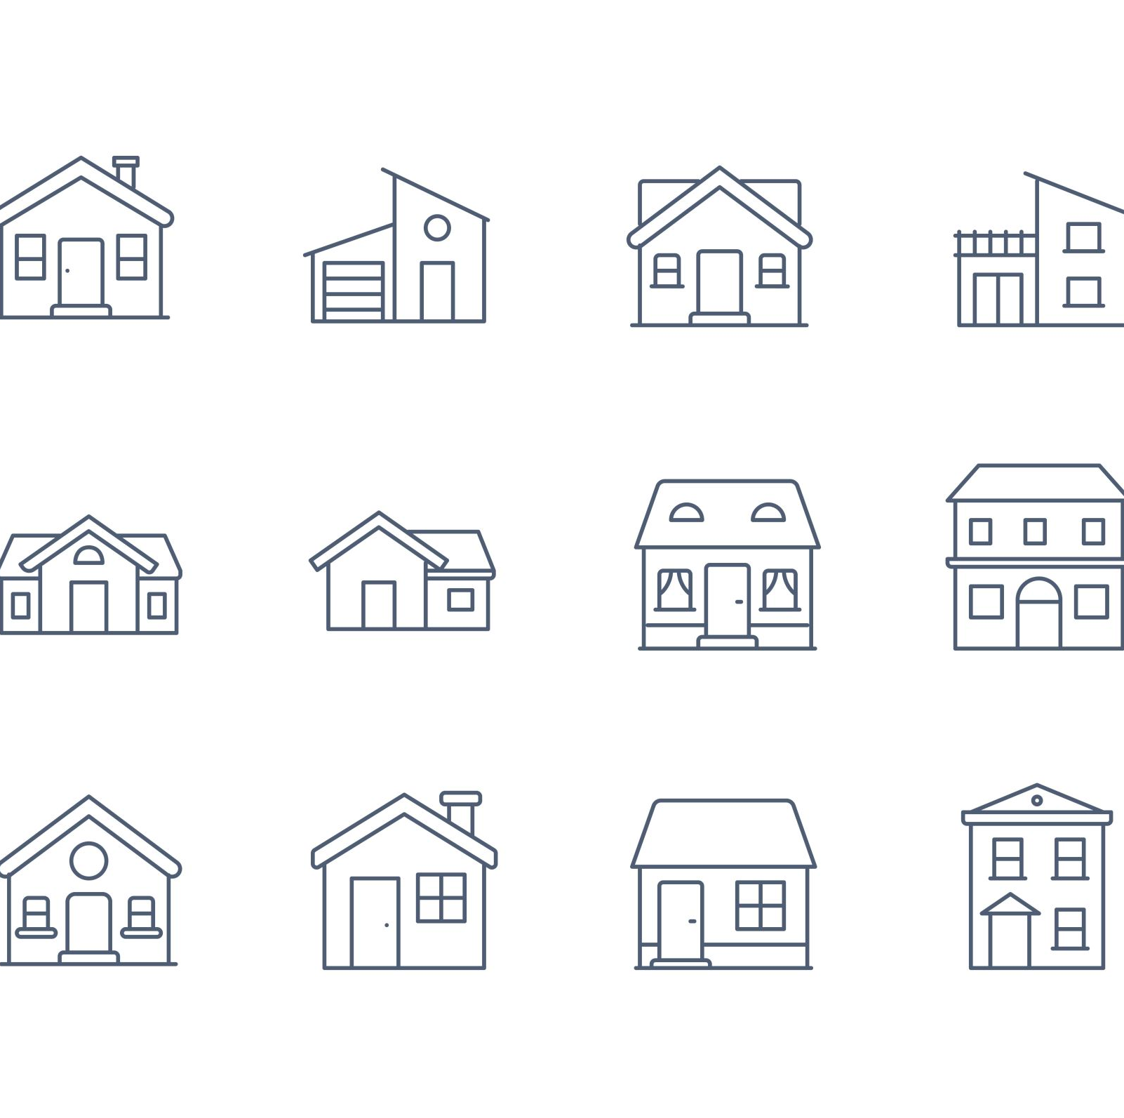
Growth of Formal Housing Finance (1970s–1980s)
HUDCO (1970):
Bulk loans to housing boards and low-income housing
HDFC (1977):
First retail housing finance company
Introduced systematic loan appraisal and repayment
NHB (1988):
Apex institution for refinance, promotion, and regulation
Example: A salaried employee in 1980s Delhi could finally access long-term home loans from HDFC — a game-changer for the middle class.

Slide 21

Role of Banks in Housing Finance
Until 1980s, banks had little exposure to housing
RBI interventions pushed banks into housing finance
Priority Sector Lending (PSL): Housing loans included in PSL by 1990s
Enabled loans for purchase, construction, and renovation
Example: In 1990s Chennai, families could approach public sector banks like Indian Bank or SBI under PSL for low-cost housing loans.

Slide 22
Market Transformation – Post Liberalization
1990s onward: Economic reforms opened financial markets
Entry of private banks and competition
Shift from seller’s market to buyer’s market
Interest rates reduced, loan options increased
Example: Early 2000s, homebuyers in Bangalore could choose from multiple lenders — HDFC, ICICI, SBI, LIC HFL — with competitive offers.

Slide 23

Loan Structures and Affordability
Loan tenures increased: 10 → 20 years
Lower EMIs via longer terms
New repayment models:
Step-up EMIs: Increase with income growth
Prepayment flexibility
Loans now available for:
Purchase, improvement, extension, repair
Example: Young IT professionals in cities like Pune could take a 20-year loan early in their career, boosting early home ownership.

Slide 24
Tax Incentives and Home Loans
Major driver of mortgage demand:
Section 24(b): Interest deduction (₹2 lakh/year)
Section 80C: Principal repayment deduction (₹1.5 lakh/year)
Lowers effective cost of borrowing
Example: A borrower paying ₹25,000/month could save ₹60,000–₹70,000 annually through tax benefits — making EMI more affordable.

Slide 25
Summary – Key Milestones
Period | Key Development
1950s–60s | Housing as welfare, public-led
1970s–80s | HUDCO, HDFC, NHB established
1990s | Banks enter housing finance, PSL inclusion
2000s | Private sector competition, product innovation
Ongoing | Tech-driven services, affordable housing focus

Slide 26

Institutions and Mechanisms in Housing Finance
Key Players in the Indian Housing Finance Ecosystem

Slide 27
National Housing Bank (NHB)
Established: 1988 (via NHB Act, 1987)
Owned by: Reserve Bank of India (initially)
Purpose: Apex financial institution for housing finance
Initial Role:
Promote housing finance institutions
Provide refinance to HFCs
Regulate HFCs
Post-2019:
Regulatory role shifted to RBI
NHB focuses on:
Refinance
Development finance
Capacity building

Slide 28
Housing Finance Companies (HFCs)
Emerged in late 1970s–80s
Pioneer: HDFC (1977)
Growth supported by NHB post-1988
Initially targeted urban salaried class
Expanded to rural and semi-urban areas
Innovations in:
Product design
Repayment structures
Customer outreach
Post-2018:
Tighter regulations under RBI
Due to IL&FS crisis and systemic risk concerns

Slide 29

Commercial Banks
Major entry during 1990s liberalization
Housing loans classified under Priority Sector Lending
Competitive edge:
Wide branch networks
Lower cost of funds
Dominant in middle- and high-income housing
Innovations introduced:
Floating-rate loans
Longer tenures
Serve both private and affordable housing segments

Slide 30

HUDCO
Established: 1970 (Public Sector)
Primary Focus: Low-cost housing and urban infrastructure
Supported programs like:
Urban Basic Services Programme
VAMBAY
Expanding role in integrated urban infrastructure prioritizing
Economically Weaker Sections (EWS)
Low-Income Groups (LIG)
Also finances:
Slum rehabilitation
Water supply and sanitation

Slide 31
LIC & GIC – Insurance-Based Funding
Large long-term fund sources
Entered housing finance in 1980s
Subsidiaries:
LIC Housing Finance Ltd. (1989)
GIC Housing Finance Ltd. (1989)
Provide stability and long-tenure funds
Key role in middle-income housing finance
Complementary to banks and HFCs

Slide 32

Cooperative Banks – Localized Lending
Long-standing history, esp. Urban Cooperative Banks
Cater to:
Local communities
Small borrowers
Serve semi-urban and rural areas
Smaller ticket loans
Strong community trust
Declined in national share post-1990s
Still vital in niche, localized markets

Slide 33
Summary
Institution | Key Focus | Strengths | Challenges
NHB | Refinance, Development | Apex body | Limited direct lending
HFCs | Retail Housing Loans | Product innovation | Regulatory compliance
Banks | Mass-market Lending | Wide reach, low-cost | Exposure risks
HUDCO | Govt Schemes & Infra | EWS/LIG support | Bureaucratic hurdles
LIC/GIC | Long-term Finance | Stability, tenure | Limited flexibility
Co-ops | Local Credit | Trust, access | Limited capital

Slide 34
Securitization

Slide 35
Securitization – Concept
Securitization involves pooling loans and selling them as securities to investors.
Helps lenders free up capital and manage risks.
Common in housing finance: Mortgage-Backed Securities (MBS)

Slide 36
Early Stage of Securitization in India
First pilot MBS issued in 2000
Faced slow uptake due to:
Low awareness
Weak investor interest
Lack of regulatory clarity

Slide 37
Challenges Hindering Growth
No standard documentation
High stamp duties on securitization deals
Ambiguity in tax treatment
MBS not explicitly recognized in securities laws

Slide 38

RBI Regulatory Intervention (2006)
RBI issued securitization guidelines covering:
True sale norms
Credit enhancement rules
Capital adequacy requirements
Increased transparency but raised transaction costs due to capital charges

Slide 39

Secondary Market Limitations
India lacks a vibrant secondary mortgage market
Consequences:
Limited liquidity for originators (especially small HFCs)
Restricts lending to underserved borrowers

Slide 40
Risk Weighting and Impact
MBS investments by banks subject to 75–100% risk weighting
Higher capital requirement discourages participation
Slows down securitization development

Slide 41
Financing Social Housing
Social housing: Aimed at urban poor & informal workers
Challenges:
Lack of formal income documentation
No collateral
Excluded from mainstream finance

Slide 42
Key Government Programs
HUDCO – Nodal agency for social housing finance
Important schemes:
VAMBAY – Slum housing for urban poor
IAY – Rural housing for BPL families
Two Million Housing Programme – National level outreach
Targeted Public Provision (TPP) – Direct housing assistance

Slide 43
Role of International Assistance
DFID (UK), KfW (Germany), JBIC (Japan):
Provide concessional loans
Offer technical support
Strengthen delivery systems and funding for housing

Slide 44
Rental Housing
Historically neglected in policy
Rent control laws discouraged private investment
Result: Growth of informal rental markets & slums

Slide 45
Barriers to Rental Housing
Outdated legislation and low returns for landlords
Lack of institutional rental housing options
Migrants and low-income groups lack affordable rentals

Slide 46
Recent Policy Efforts
Model Tenancy Act introduced
Aims to:
Balance landlord-tenant rights
Promote private rental markets
Adoption by states remains low

Slide 47

INFORMAL SECTOR

Slide 48

Informal Sector – Who Are They?
Friends, family, moneylenders, shopkeepers
Operate outside formal financial system
No formal contracts or paperwork

Slide 49

Informal Sector – Key Characteristics
Small, short-term, unsecured loans
Flexible repayments (daily/weekly)
High interest rates
High accessibility, especially for the unbanked

Slide 50
Example
₹5,000 borrowed from a moneylender for roof repair; paid in 2–3 months Limitations:
Risk of exploitation
No legal protection
Can lead to debt traps

Slide 51
SEMI-FORMAL INSTITUTIONS
Sit between informal and formal
Examples:
Chit Funds
Pawnbrokers
Community Savings Groups

Slide 52
Chit Funds – How They Work
Group savings model
Monthly contributions pooled and distributed via lottery or bidding Example: 20 families contribute ₹1,000 each → ₹20,000 pool given to one member per month

Slide 53
Pawnbrokers – Collateral-Based Lending
Loans against pledged items (jewelry, tools)
Accessible but excludes those without assets
Limitations:
Risk of fraud
No formal grievance redressal
Poor may still be excluded due to contribution/collateral requirements

Slide 54
Government Support for LIG/EWS
Subsidized loans, refinance, and guarantees
Encourage incremental construction
Support for self-built housing
Key Public Initiatives
Swarna Pragati Housing Microfinance (SPHM) – Small rural housing loans
NHB-IFC Toolkit – Guidelines for housing microfinance
Priority Sector Lending – Small loans with relaxed norms

Slide 55
Why Public Sector Matters
Bridges the gap between informal credit and full home loans
Addresses the needs of:
Informal income households
First-time borrowers
Rural and semi-urban poor

Slide 56
Private Formal Sector Lenders
Commercial banks, NBFCs, Housing Finance Companies
Operate with:
Legal contracts
Credit scoring
Property title verification

Slide 57
Challenges in Reaching the Poor
Need for:
Proof of income
Credit history
Legal land titles
Risk perception is high
Reluctance to issue low-value or unsecured loans

Slide 58
Innovations & Partial Inclusion
Lower ticket-size loans
Co-borrowers allowed
Partial collateral accepted Many poor remain excluded due to formal entry barriers

Slide 59
NGOs & COMMUNITY-BASED ORGANIZATIONS
Work within communities
Use local trust, group responsibility, and social networks
Provide loans and also:
Technical help
Construction support
Monitoring

Slide 60
Key NGO Examples
Mahila Milan (Mumbai):
Small loans with minimal service charge
Peer accountability
MicroBuild Fund (Habitat):
Global fund supporting shelter finance
SPARC, SEWA, CHF:
Slum upgrading + subsidies + housing microfinance

Slide 61
NGO Strengths & Weaknesses
Strengths:
High repayment due to peer pressure
Deep local knowledge
Tailored support
Limitations:
Scale is small
Dependent on donors/subsidies
Capital constraints

